Slide 1
AI assisted thematic analysis

Slide 2
Thematic Analysis (Braun & Clarke, 2006) – Six Phases
Familiarize yourself with the data
  Read (and re-read) the transcripts or texts, note initial impressions, and start thinking about possible patterns.
Generate initial codes
  Work systematically through the dataset, tagging interesting features (words, phrases, passages) that relate to your research questions.
Search for themes
  Cluster related codes together to form potential themes—coherent categories that seem meaningful and broader than single codes.
Review themes
Define & name themes
  Refine each theme’s scope and focus, identify sub-themes if useful, and craft concise, evocative names plus short definitions.
Produce the report
  Weave the final themes into an analytic narrative, choose vivid extracts to illustrate them, relate findings back to research questions and literature, and discuss implications.

Slide 3
Problem
Thematic analysis is time-consuming and labor-intensive, demanding manual coding and repeated reviews before meaningful insights surface.
Technical gap limiting the researchers in their ability to harness AI capabilities effectively
Without ongoing interaction with the user, an AI system can gradually drift from the original intent during multi-step tasks, producing results that no longer fully reflect the user’s needs

Slide 4
Initial Solution + baseline
Paper Using Large Language Models to Support Thematic Analysis in Empirical Legal Studies
AI capability to conduct individual steps of the Thematic analysis well documented and tested
Limitations
  High barrier for non-coders, as interaction is limited to programmatic calls
  Insufficient “Human in the loop” feedback
  Context and rate limits, outdated models
  Little visibility into the AI’s underlying logic
  No easy way to browse/edit/delete/add underlying data

Slide 5
DEMO

Slide 6
AI Assisted Thematic Analysis App
Accessible with 0 coding skills
Segmented modules
Iterative Human-in-the-loop approach
End-to-end execution/isolated components
Plug in human generated data at any step

Slide 7
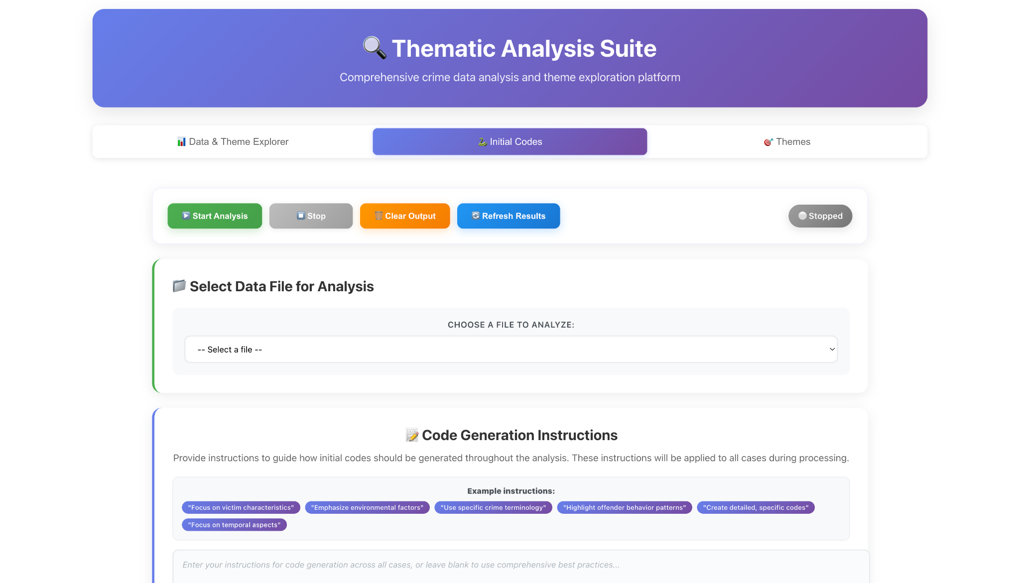

Slide 8
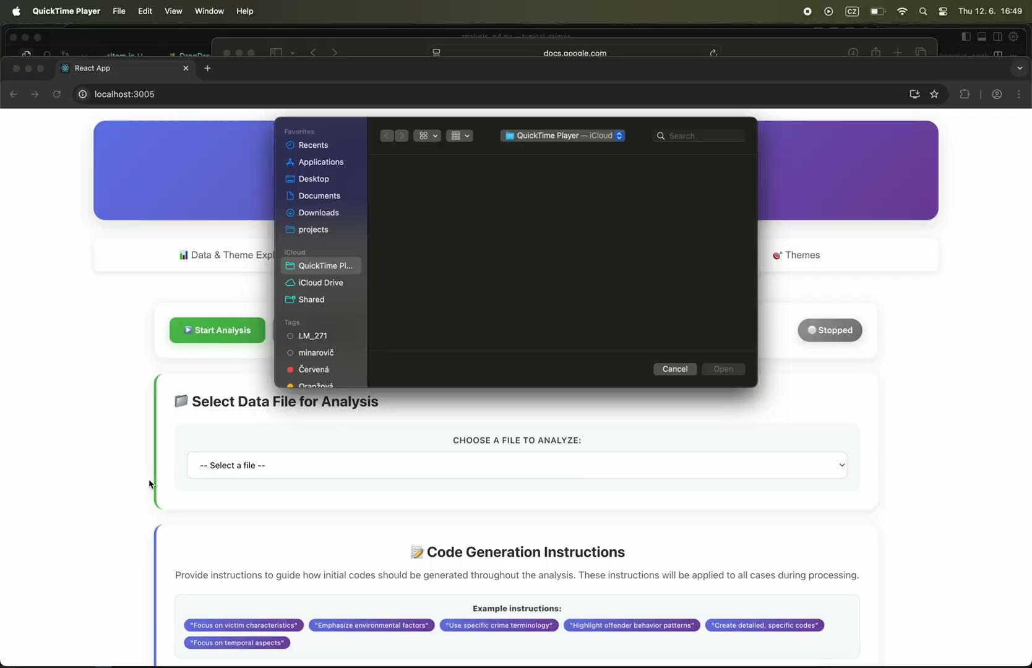
link

Slide 9
Future improvements
Last Modal - Assigning themes to the individual data points
Embeddings - AI merge suggestions
Visibility into how the system operates and what occurs under the hood - stop/revert/reiterate
100% control of prompts and used AI models
User-supplied API

